Slide 1
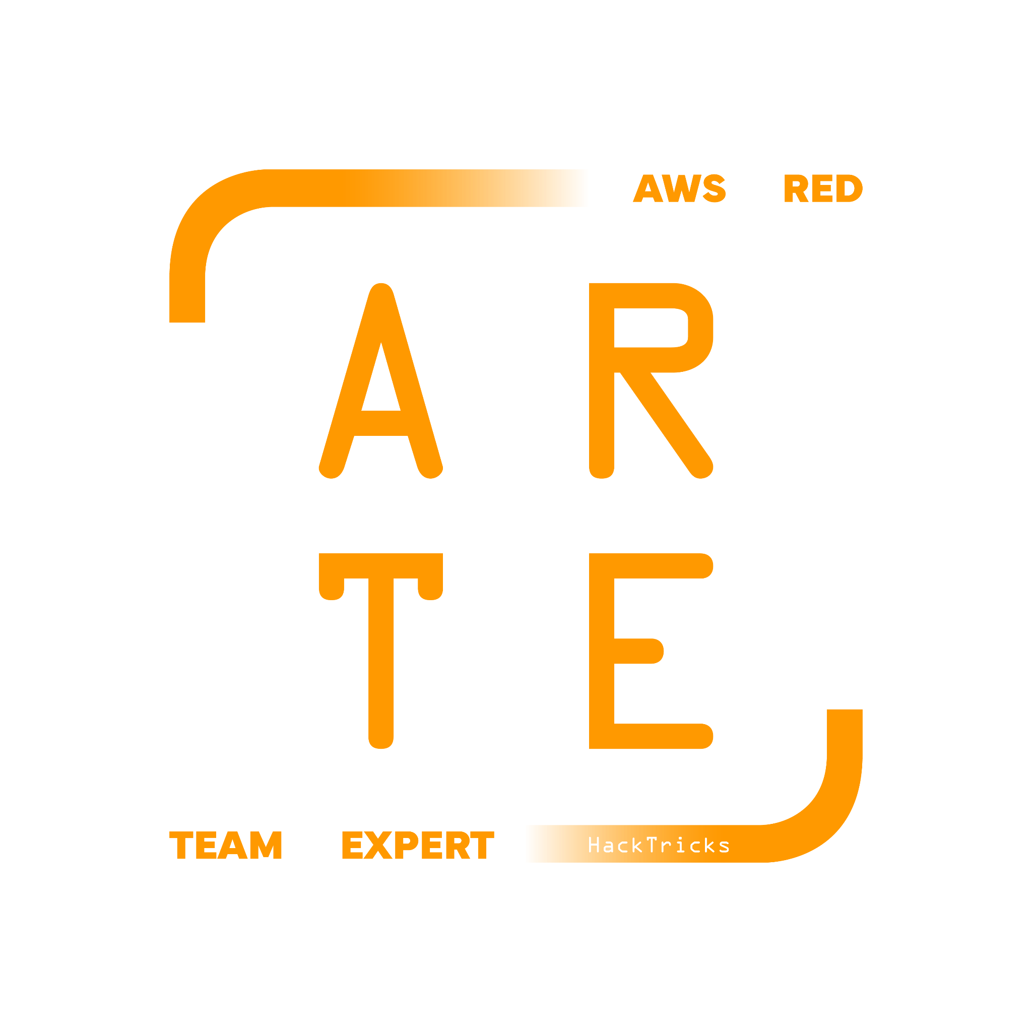
ECR
Elastic Container Registry
HackTricks Training
https://t.me/CyberFreeCourses

Slide 2
Basic Information
Amazon Elastic Container Registry (Amazon ECR) is a managed container image registry service. Customers can use the familiar Docker CLI, or their preferred client, to push, pull, and manage images.
ECR is compose by 2 types of objects: Registries and Repositories.
https://t.me/CyberFreeCourses
https://cloud.hacktricks.xyz/pentesting-cloud/aws-security/aws-services/aws-ecr-enum

Slide 3
Registries & Repositories
Registries
Every AWS account has 2 registries: Private & Public. Private Registries:
Private by default: The container images stored in an Amazon ECR private registry are only accessible to authorized users within your AWS account or to those who have been granted permission.
The URI of a private repository follows the format <account_id>.dkr.ecr.<region>.amazonaws.com/<repo-name>
Access control: You can control access to your private container images using IAM policies, and you can configure fine-grained permissions based on users or roles.
Integration with AWS services: Amazon ECR private registries can be easily integrated with other AWS services, such as EKS, ECS…
More configuration options
https://t.me/CyberFreeCourses
https://cloud.hacktricks.xyz/pentesting-cloud/aws-security/aws-services/aws-ecr-enum

Slide 4
Registries & Repositories
Registries
Every AWS account has 2 registries: Private & Public.
Public Registries:
Public accessibility: Container images stored in an ECR Public registry are accessible to anyone on the internet without authentication.
The URI of a public repository is like public.ecr.aws/<random>/<name>. Although the <random> part can be changed by the admin to another string easier to remember.
Uses region us-east-1
Repositories
These are the images stored in the private registry or to the public one.
https://t.me/CyberFreeCourses
https://cloud.hacktricks.xyz/pentesting-cloud/aws-security/aws-services/aws-ecr-enum

Slide 5
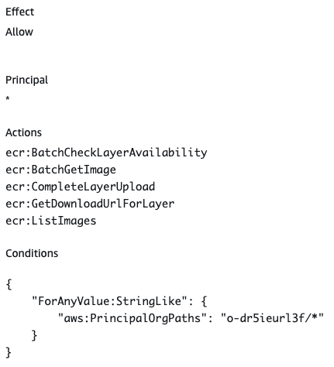
Resource Policies
Registries & repositories also have policies that can be used to grant permissions to other principals/accounts. For example, in the following repository policy image you can see how any user from the whole organization will be able to access the image:
https://t.me/CyberFreeCourses
https://cloud.hacktricks.xyz/pentesting-cloud/aws-security/aws-services/aws-ecr-enum

Slide 6
Manual Enumeration
# Get registries & repos
aws ecr describe-registry
aws ecr describe-repositories
# Get image metadata
aws ecr list-images --repository-name <repo_name>
aws ecr describe-images --repository-name <repo_name>
aws ecr describe-image-replication-status --repository-name <repo_name> --image-id <image_id>
aws ecr describe-image-scan-findings --repository-name <repo_name> --image-id <image_id>
aws ecr describe-pull-through-cache-rules --repository-name <repo_name> --image-id <image_id>
# Get public repositories
aws ecr-public describe-repositories
# Get policies
aws ecr get-registry-policy
aws ecr get-repository-policy --repository-name <repo_name>
https://t.me/CyberFreeCourses
https://cloud.hacktricks.xyz/pentesting-cloud/aws-security/aws-services/aws-ecr-enum

Slide 7
Unauth Access
Repositories in public registry
Repositories in private registries with registry or repository policy too open
https://t.me/CyberFreeCourses
https://cloud.hacktricks.xyz/pentesting-cloud/aws-security/aws-unauthenticated-enum-access/aws-ecr-unauthenticated-enum

Slide 8
Privilege Escalation
ecr:GetAuthorizationToken,ecr:BatchGetImage
Login & download images
ecr:GetAuthorizationToken,ecr:BatchCheckLayerAvailability,ecr:CompleteLayerUpload,ecr:InitiateLayerUpload,ecr:PutImage,ecr:UploadLayerPart
Login & upload images
ecr:SetRepositoryPolicy
Change the repository (image) policy
ecr:PutRegistryPolicy
Change the registry policy
Their equivalents in ecr-public:*
https://t.me/CyberFreeCourses
https://cloud.hacktricks.xyz/pentesting-cloud/aws-security/aws-privilege-escalation/aws-ecr-privesc

Slide 9
Post Exploitation
Pull
Search for sensitive information on each repository you have access to
Push
Compromise repositories that are being used in production inserting a backdoor on them
ecr:PutLifecyclePolicy | ecr:DeleteRepository | ecr-public:DeleteRepository | ecr:BatchDeleteImage | ecr-public:BatchDeleteImage
Delete stuff
https://t.me/CyberFreeCourses
https://cloud.hacktricks.xyz/pentesting-cloud/aws-security/aws-post-exploitation/aws-ecr-post-exploitation

Slide 10
Persistence
DEMO
Backdoor an image
Repository Policy
Registry Policy + Cross-account replication
https://t.me/CyberFreeCourses
https://cloud.hacktricks.xyz/pentesting-cloud/aws-security/aws-persistence/aws-ecr-persistence
Notes:
# Public Enumeration
aws ecr-public describe-repositories --region us-east-1
# Private Enumeration
aws --region eu-central-1 ecr describe-repositories
aws ecr describe-registry --region eu-central-1
aws --region eu-central-1 ecr describe-images --repository-name docker-ps-spy
aws --region eu-central-1 ecr get-repository-policy --repository-name docker-ps-spy
# Public
s="-H unix:///Users/lowuser/.docker/run/docker.sock"
aws ecr-public get-login-password --region us-east-1 | docker $s login --username AWS --password-stdin public.ecr.aws/u9e0j0r8
docker $s images
### Overwrite docker-ps-spy
docker $s build -t docker-ps-spy .
docker $s tag docker-ps-spy:latest public.ecr.aws/u9e0j0r8/docker-ps-spy:latest
docker $s push public.ecr.aws/u9e0j0r8/docker-ps-spy:latest
# Private
aws ecr get-login-password --region eu-central-1 | docker $s login --username AWS --password-stdin 947247140022.dkr.ecr.eu-central-1.amazonaws.com
docker $s images
# From repository policy
aws --profile nopriv ecr get-login-password --region eu-central-1 | docker $s login --username AWS --password-stdin 947247140022.dkr.ecr.eu-central-1.amazonaws.com
docker $s pull 947247140022.dkr.ecr.eu-central-1.amazonaws.com/docker-ps-spy
aws --region eu-central-1 ecr get-repository-policy --repository-name docker-ps-spy
aws ecr set-repository-policy \
--repository-name docker-ps-spy \
--policy-text file:///tmp/my-policy.json \
--region eu-central-1
aws --profile nopriv ecr get-login-password --region eu-central-1 | docker $s login --username AWS --password-stdin 947247140022.dkr.ecr.eu-central-1.amazonaws.com
docker $s pull 947247140022.dkr.ecr.eu-central-1.amazonaws.com/docker-ps-spy

